Slide 1
Beta 4
Super allowed transitions
K-capture
neutrinos

Slide 2















































Slide 3









































Slide 4








Slide 5















































Slide 6



































Slide 7

















































Slide 8







































Slide 9






























Slide 10



















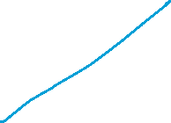












Slide 11
































Slide 12











































Slide 13



































Slide 14
































